Slide 1
EPA assignment of IMPROVE Organic Matter Carbon to natural vs anthropogenic contributions
Data from Scott Copeland’s IMPROVE data set
Episodic Extreme Event (E3) Carbon Threshold intended to identify wildfire events:
defined as the minimum 95% value in the period 2000-2014 for carbon (Organic Matter Carbon, OMC, plus Elemental Carbon, EC)
Same carbon threshold applied every year
Because ratio of OMC to EC varies daily, E3 for OMC and EC varies daily
E3 OMC = E3 carbon x OMC/(OMC+EC)
Natural Routine OMC = Fraction of annual average NCII OMC divided by measured annual average OMC mulitipled by daily non-episodic OMC (same fraction applied to daily values in a year; fraction varies annually)
Anthropogenic OMC = Total daily OMC – daily routine natural OMC

Slide 2
EPA estimated episodic natural, routine natural, and anthropogenic contributions to 2011 OMC for example western sites

Slide 3
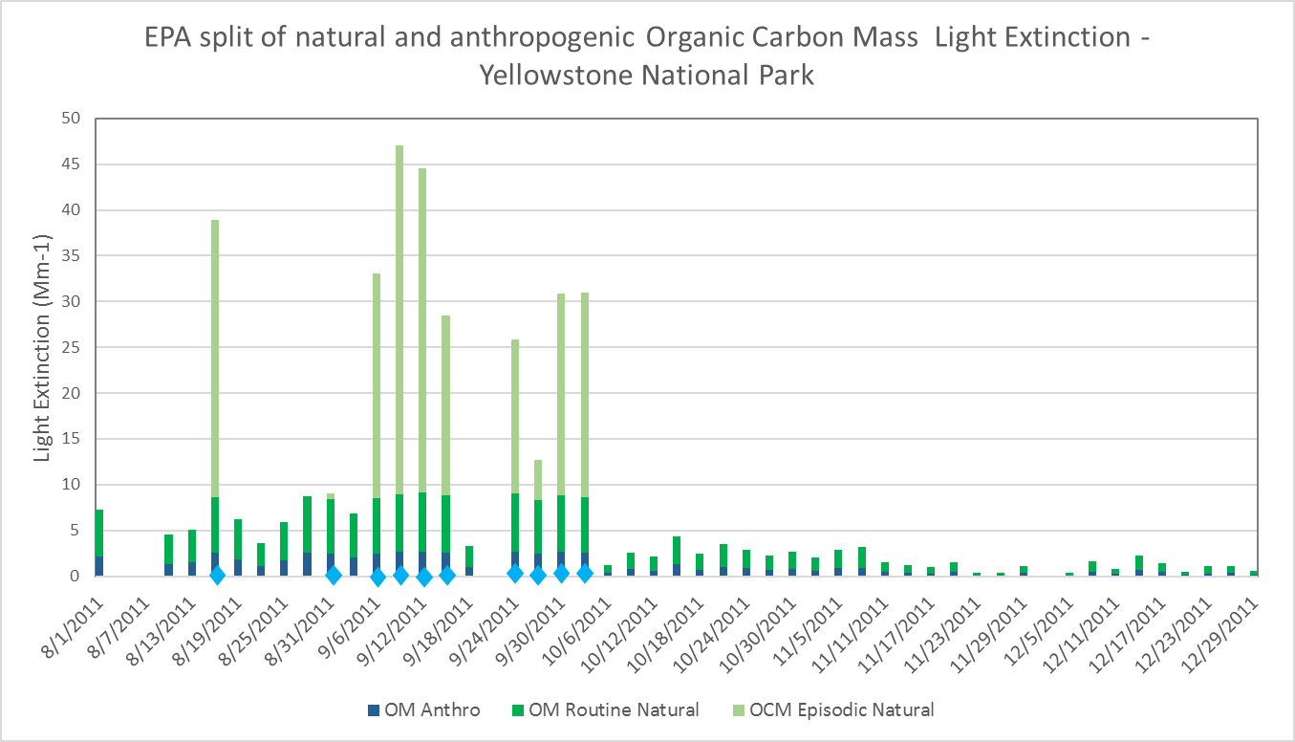

Slide 4
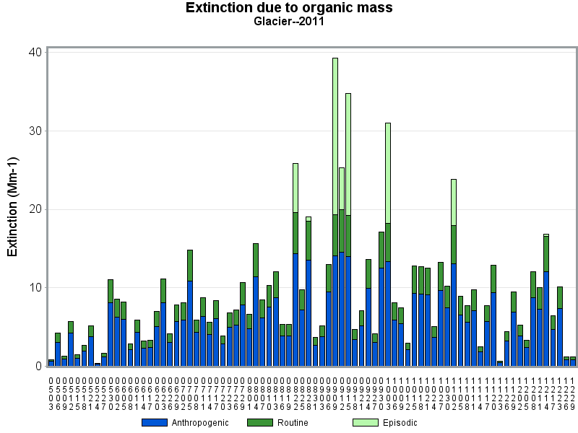

Slide 5
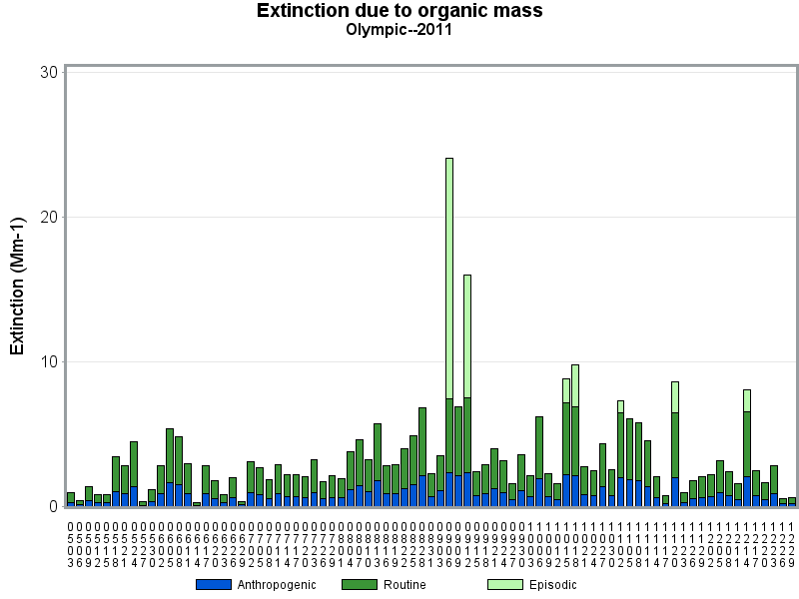

Slide 6
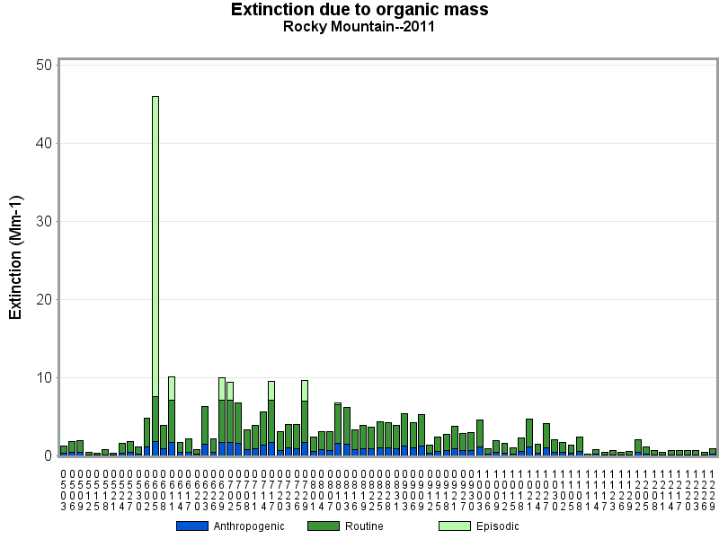

Slide 7
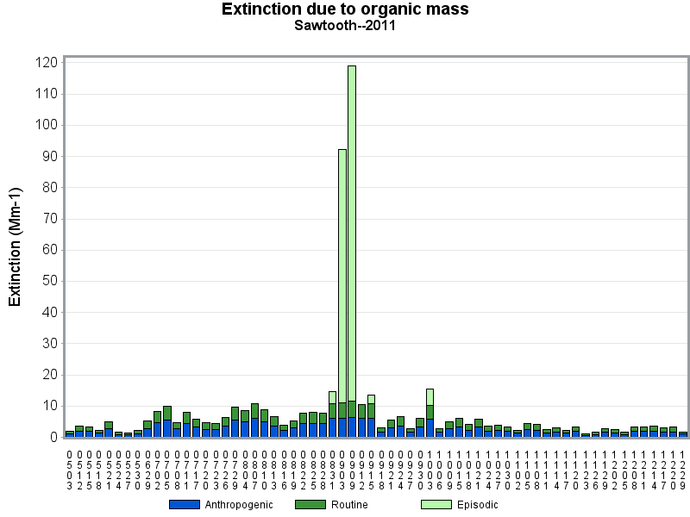

Slide 8
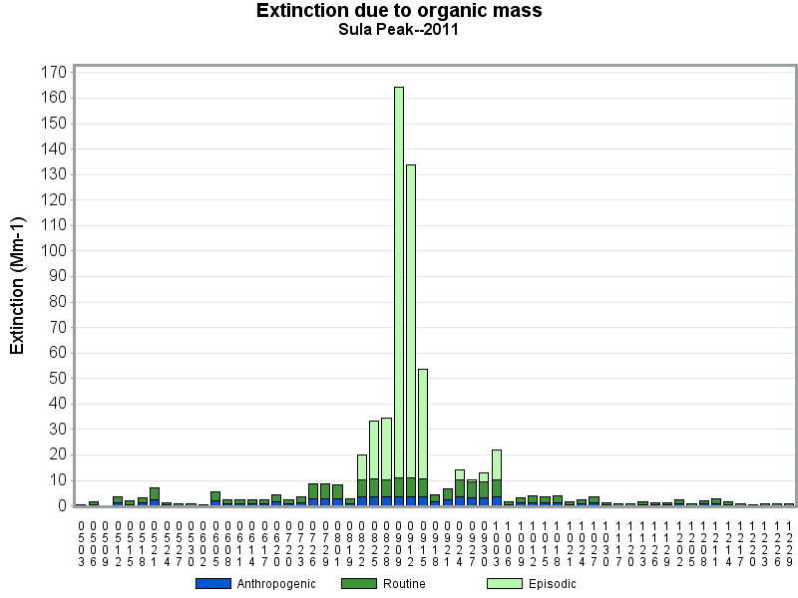

Slide 9
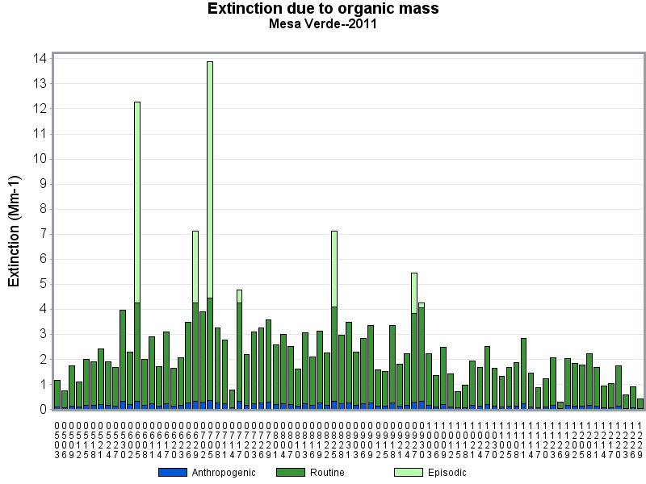

Slide 10
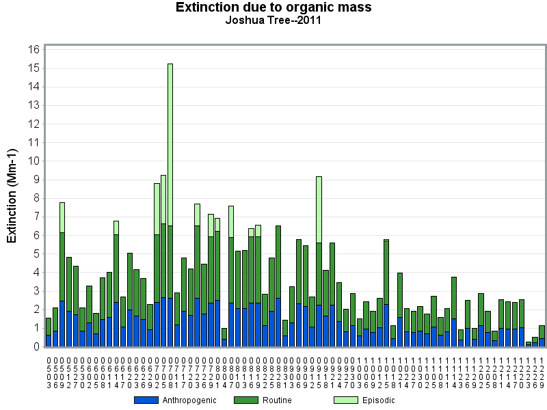

Slide 11
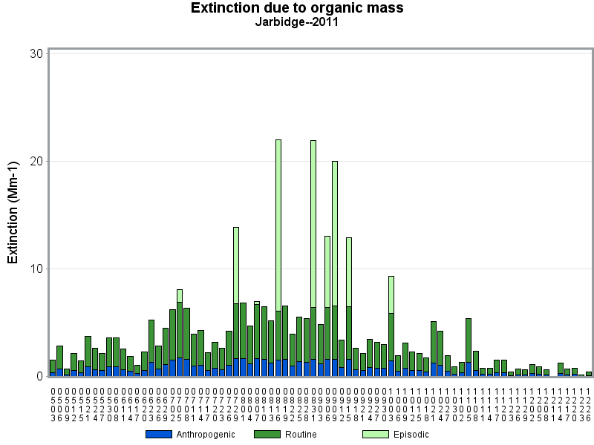

Slide 12
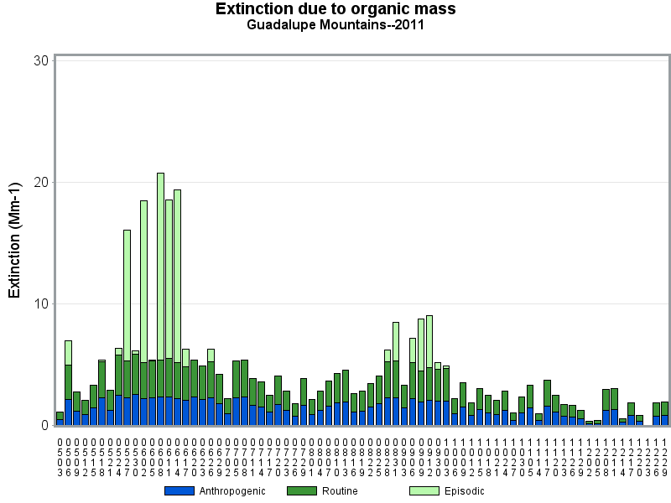

Slide 13
